Slide 1
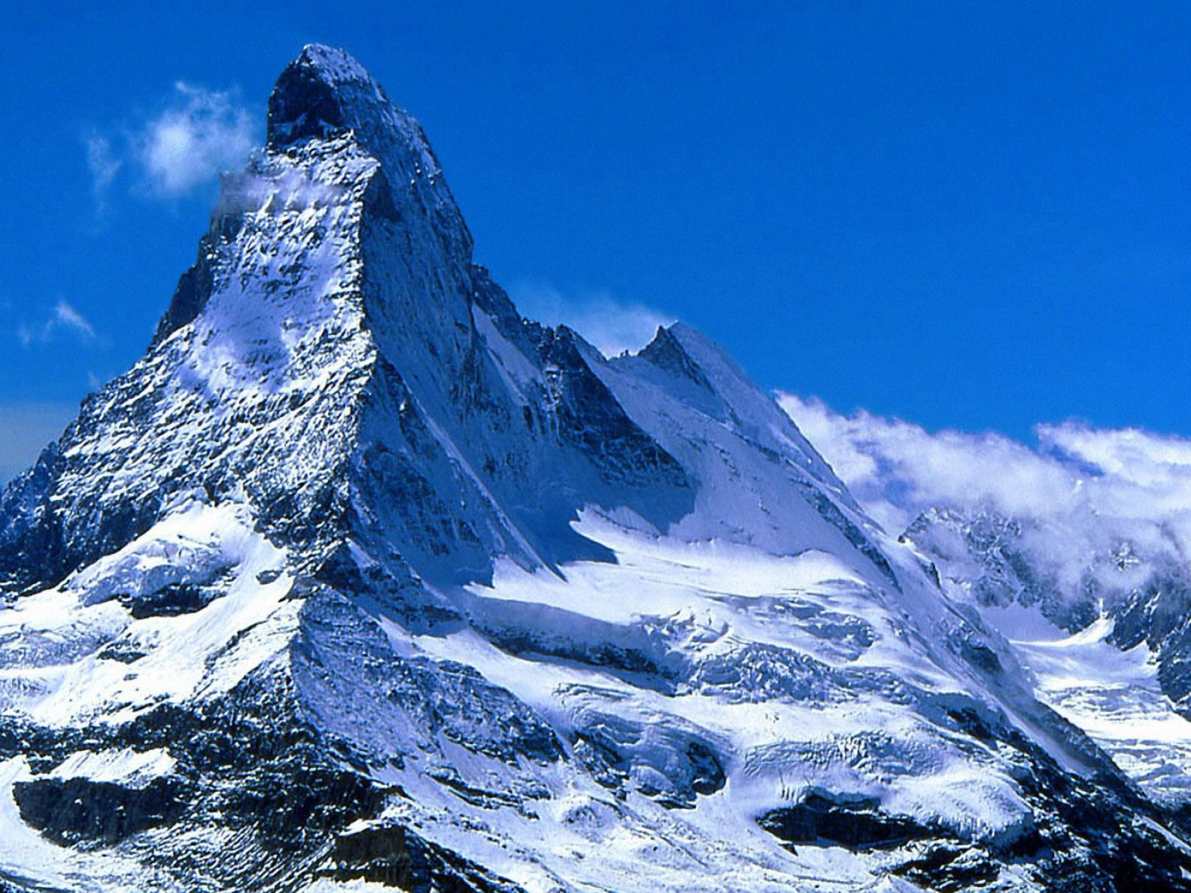


Toward Software/Application Driven Computer Networks
杨阳 （Y. Richard Yang ）
Yale University, Tongji University
November 16, 2015
深圳－中国
Notes:
What does it mean to say software-driven? For large network equipment vendors, software cost already accounts for 90% of R&D cost.

Slide 2

Software Driven, Programmable Networks are not New
We are focusing on a market transition involving the move toward more programmable, flexible, and virtual networks… This transition is focused on moving from a hardware-centric approach for networking to a virtualized network environment that is designed to enable flexible, application-driven customization of network infrastructures.
- Cisco Annual Report (pp2), Nov. 2015
Notes:
To appeal to companies looking for more highly customized systems, Cisco has also opened up its software to programmers in new ways, making it easier for clients to write their own apps for Cisco products.
http://www.bloomberg.com/news/articles/2015-11-05/cisco-s-new-ceo-embraces-the-cloud

Slide 3
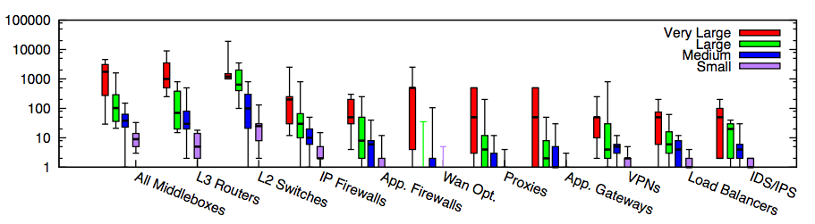
Why: Modern Network Diversity
Modern networks increasingly contain multiple types of equipment
In traditional settings, each type/vendor runs in its own hardware box
Substantial flexibility/eff. if more programability
Small: <=1k hosts; Medium: 1k-10k; Large: 10k-100k; Very Large: >= 100k
Source: [Sherry, et. al SIGCOMM’12]
Notes:
为啥呢？因为total ownership cost少。1. 我server买了，3年合同以后可以自行切换。前三年load cisco的virtual router，后三年load juniper的virtual switch。再过三年load palo alto的virutal firewall 2. 设备performance更新，只需要换低层硬件，就可以扩展
Router, switch, firewall merge
Server + software, which include Router, Switch, FT
DC -> Cloud
ENT switch reducing; Cloud increasing
There are more virtual ports than physical ports, where the virtual ports are controlled by x86 software. Where software erodes hardware

Slide 4
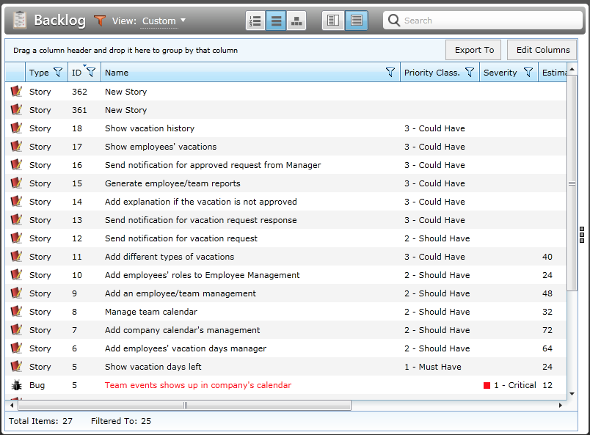
Why: Network Customization, Feature Requests Can be a Slow Process

Slide 5
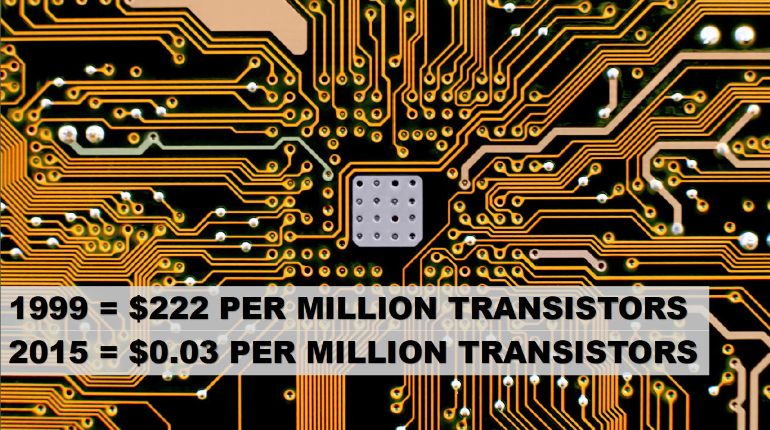
Why: Hardware Loses Value Fast
Source: Phil McKinney, 2015.
Notes:
7400 http://events.linuxfoundation.org/sites/events/files/slides/odls15_mckinney.pdf

Slide 6
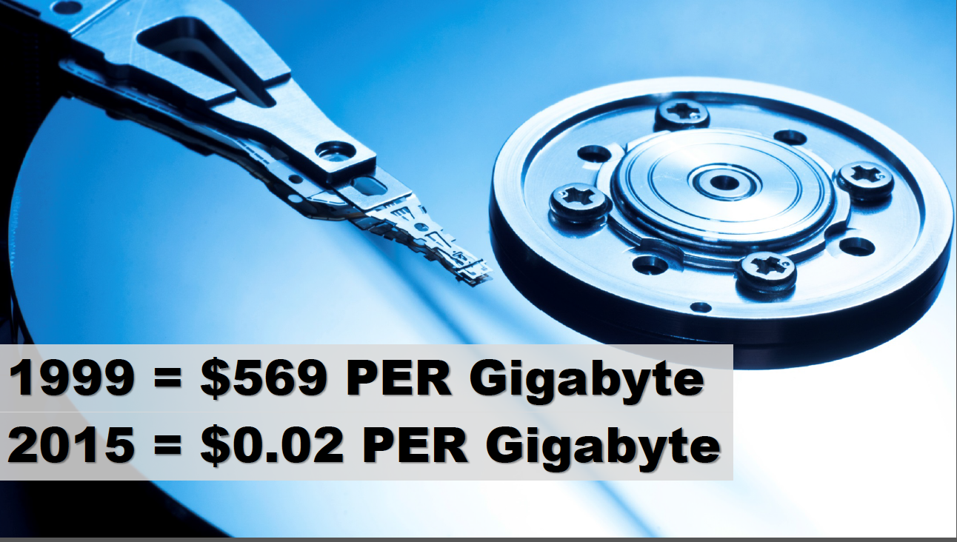
Why: Hardware Loses Value Fast
Source: Phil McKinney, 2015.
Notes:
28450

Slide 7
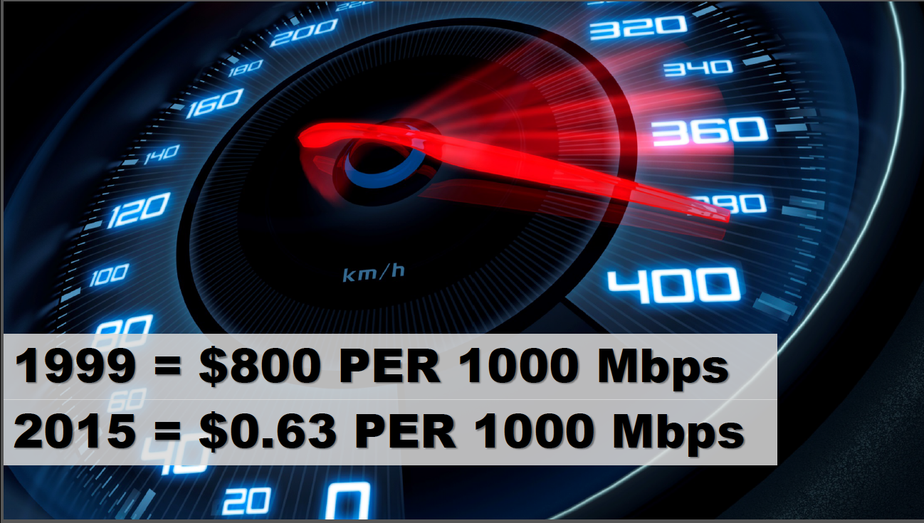
Why: Hardware Loses Value Fast
Source: Phil McKinney, 2015.
Notes:
1269

Slide 8
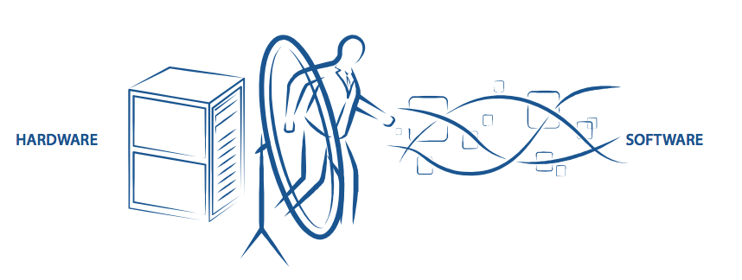
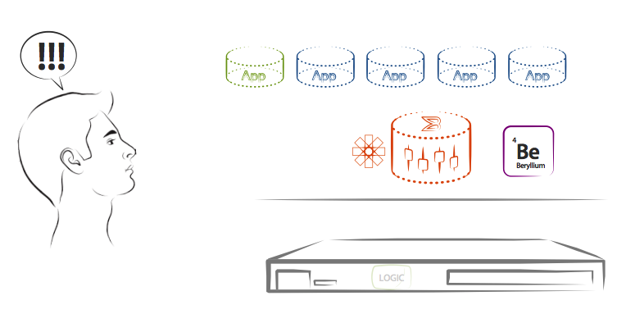
Potential Solution: Better Softwarization Allowing Flexible Network Programming
Source: Kelly Herrell, SVP, Brocade, 2015.
Notes:
http://events.linuxfoundation.org/sites/events/files/slides/odls15_herrell.pdf

Slide 9
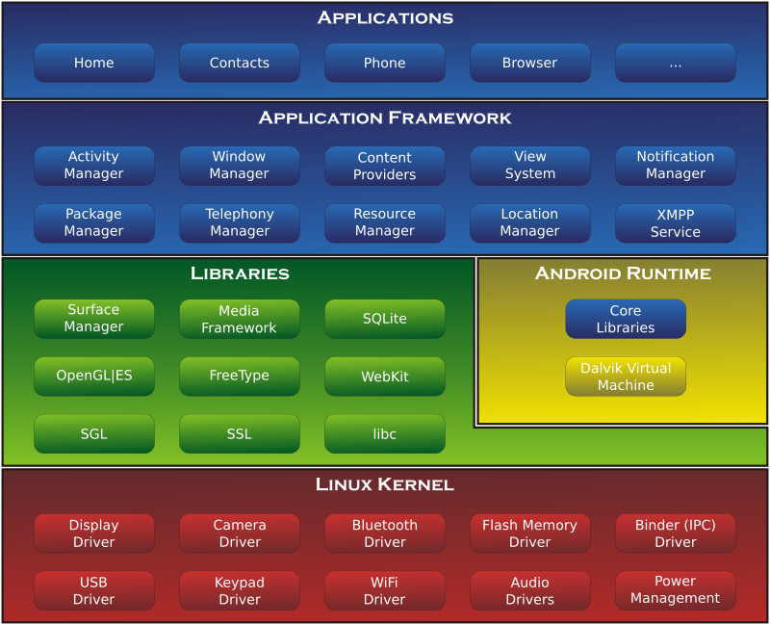
A Potential Analogy: Android
Source: https://en.wikipedia.org/wiki/Android_(operating_system)#/media/File:Android-System-Architecture.svg
Notes:
http://events.linuxfoundation.org/sites/events/files/slides/odls15_herrell.pdf

Slide 10
Mobile App vs Network App
Reliability
/security
/performance requirements
Net
Mobile
Diversity of apps

Slide 11
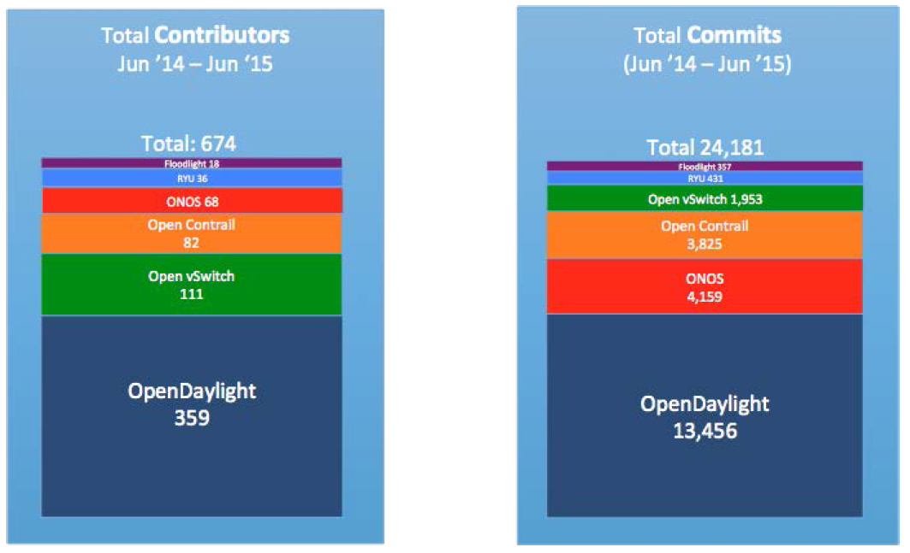
State of Art (Open Source) Players
Source: Neela Jacques, July 2015.

Slide 12
OpenDaylight Architecture
Network Devices
Applications
Network Applications Orchestration & Services
Network Devices
Applications
Network Devices
Applications
Controller
NETCONF SERVER
Protocol Plugin
...
Protocol Plugin
App/Service Plugin
...
App/Service Plugin
RESTCONF
Plugins & Applications
Config Subsystem
Model-Driven SAL (MD-SAL)
Controller Platform
Messaging
Data Store
Clustering
Remote Controller Instance
Remote Controller Instance
Source: Ed Warnicke, July 27, 2015.

Slide 13
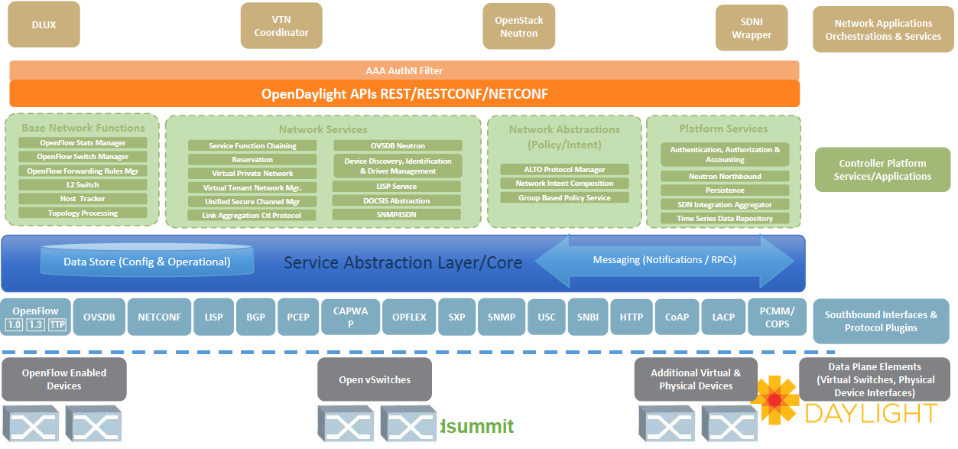
OpenDaylight Architecture
Does this architecture have enough as a base of network softwarization?
Source: Neela Jacques, July 2015.
Notes:
http://www.bigdatalandscape.com/

Slide 14
My “Biased” Assessment
Existing work has made good progress
But, the state-of-art is substantially lacking in fundamental pieces (challenges as well as opportunities)

Slide 15


OpenDaylight: Workflow and Missing Pieces
Lacking support of composition
Admin/UI
Low-level assembly programming (datapath dependency)
Northbound
Services/Apps
Path Compute Alg
GBP
L3/2 VPN
Service Chain
…
Topology/Inventory Manager
Flow Rule Manager
Southbound
Limited datapath model
Lacking in abstraction/protection mechanisms

Slide 16
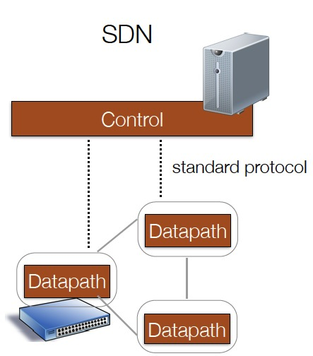
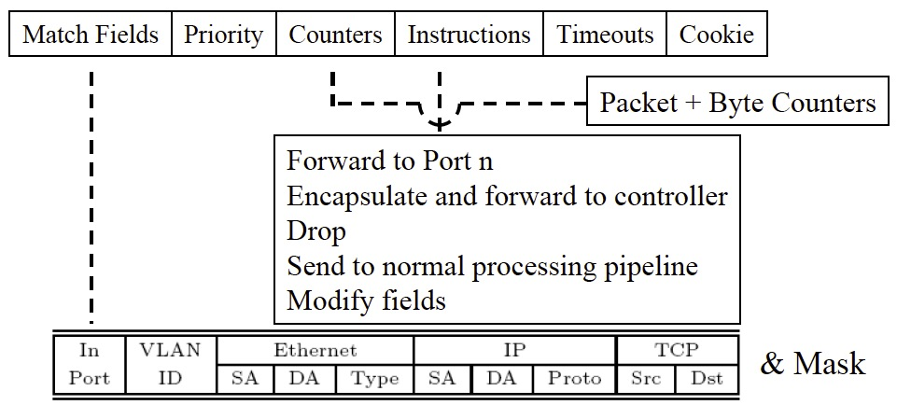
Low-Level “Assembly” Programming Model
Low-level, limited, flow table computation models (e.g., no logical negations)
Evolving, increasingly complex forwarding models (e.g., OF1.0, OF1.3, P4)

Slide 17
Way Forward: From Assembly Programming to High-level Programming
Applications/services expressed in a general purpose language that describes how a packet should be processed, not how data path are configured
Written in a familiar language such as Java, Python, or Haskell (not also the assembly part).
A compiler or runtime generates and manages data path automatically

Slide 18

One Step Leads to Another
What should be the data path of network devices?
Flow table
VM/Container

Slide 19
Insight: Datapath as Memorization Tables
Computation has two equivalent representations: instructions or memorization tables
Instructions
0. Route onPacketIn(Packet p) {
1. Switch srcSw = macTable.get( p.ethSrc() );
2. Switch dstSw = macTable.get( p.ethDst() );
return myRoutingAlg(srcSw, dstSw);
}
ethSrc
ethDst
Data Path as Lambda Memorization Table
Line 1 (macTable)
Line 2 (macTable)
ethSrc | ethDst | Action
srcSw
dstSw
Line 3 (topology)
route

Slide 20
Insight: Datapath as Memorization Tables
0. Route onPacketIn(Packet p) {
1. Switch srcSw = macTable.get( p.ethSrc() );
2. Switch dstSw = macTable.get( p.ethDst() );
3. return myRoutingAlg(srcSw, dstSw);
4. }
Instructions
ethSrc | Action
A | Reg1 = 01; jump T2
ethDst | Action
B | Reg2 = 02; jump T3
ethSrc
ethDst
Line 1 (macTable)
Line 2 (macTable)
srcSw
dstSw
Reg1 | reg2 | Action
01 | 02 | route
Line 3 (topology)
Data Path as Lambda Memorization Table
route

Slide 21
Software Architecture w/ Network Program Lang
Automatic generate memorization tables; capture (closure) and maintain consistency w/ state
Admin/UI
Service/App
ACL
L3/2 VPN
Service Chain
Shortest Path
AbstractViews
DeviceModel
fACL
fL3/2 VPN
fService Chain
f…
DeviceModel
PhysicalView
Packet-Processor-Independent Processing
DeviceModel
Southbound
Infrastructure Layer

Slide 22
Summary and Next Steps
High-level, datapath oblivious, composable programming models
From reactive programming to proactive (e.g., learning) programming
Compiler/runtime/libraries to substantially simplify network softwarization programming
Stable, hardware-efficient, software-integrated data path
Notes:
http://events.linuxfoundation.org/sites/events/files/slides/odls15_herrell.pdf

Slide 23
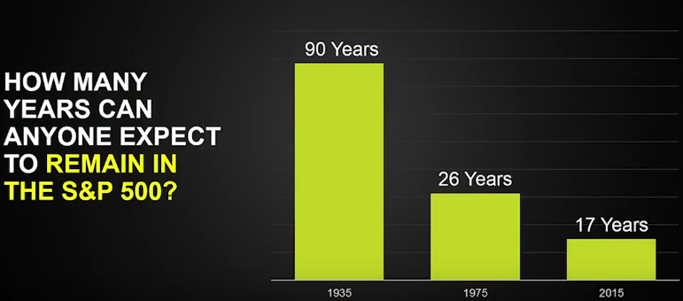
New Chances
Benefits of incumbency are declining
Source: Babson Olin School of Business, Fast Company, 2015
Notes:
40% of SP500 will disappear in the next decade. 50 of 100 IT. CEO of VMWare. Babson Olin School of Business, Fast Company
Reasons a success company that fails, miss transitons, being succ too long.

Slide 24
Thank you!

Slide 25
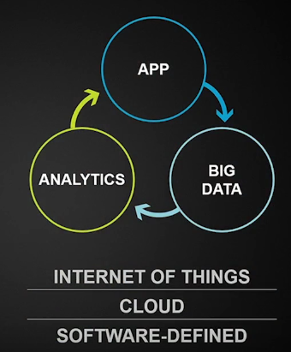
Next Step: Proactive/Learning Network Software
Source: Patrick Gelsinger, VMWare 2015.
Notes:
Algorithms + Data Structures == Program

Slide 26
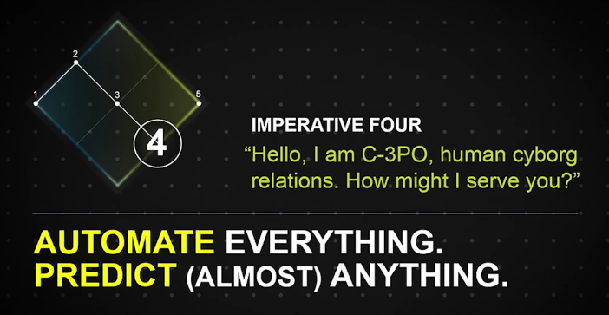
Next Step: Proactive/Learning Network Software
Source: Patrick Gelsinger, 2015.

Slide 27
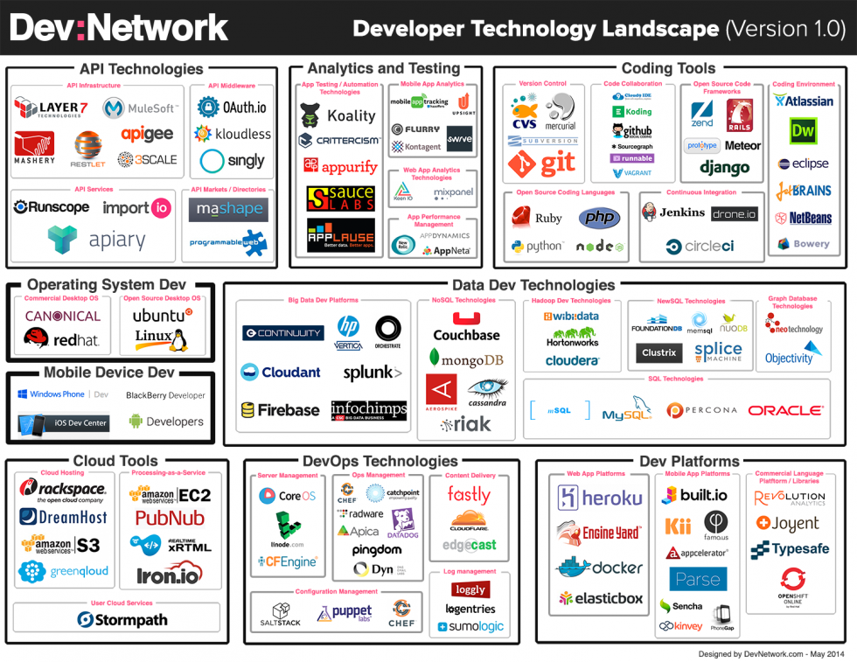
Backup

Slide 28
Software Centrism & The New Normal
http://events.linuxfoundation.org/sites/events/files/slides/odls15_herrell.pdf

Slide 29
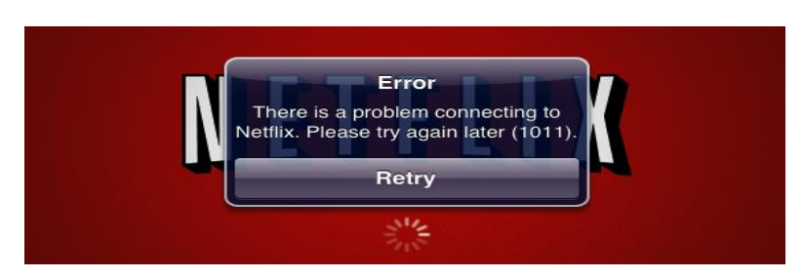
Why Care Networks
http://events.linuxfoundation.org/sites/events/files/slides/Sobanski_ODL_Summit_2015.pdf

Slide 30
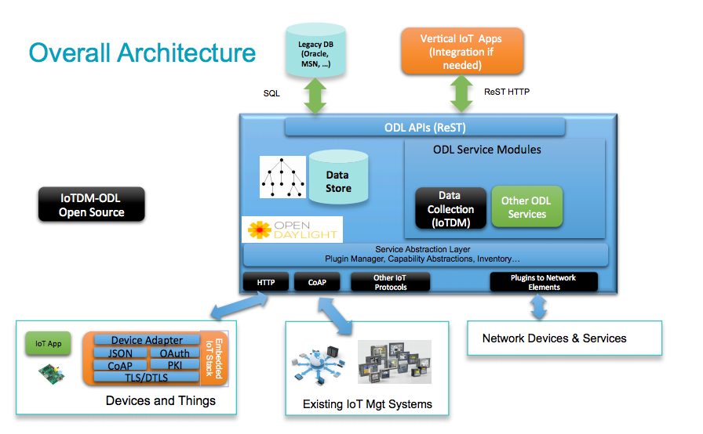
SDN + IOT
http://events.linuxfoundation.org/sites/events/files/slides/ODL-Summit_v2.pptx_.pdf

Slide 31
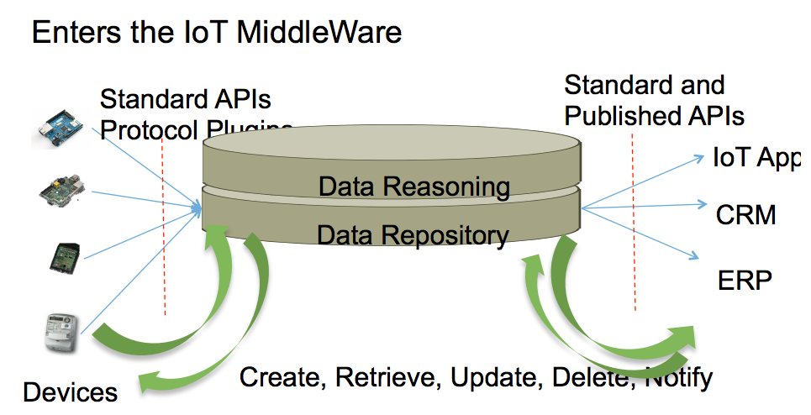
SDN + IOT

Slide 32
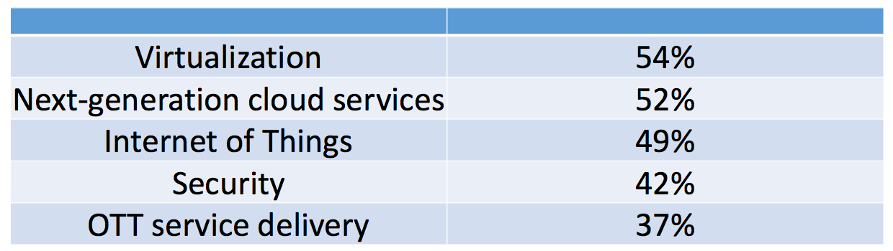
Interest of Areas
Which areas will have the biggest impact on the telecom industry over the next five years?
Source: Heavy Reading service provider survey, November 2014, n=144

Slide 33
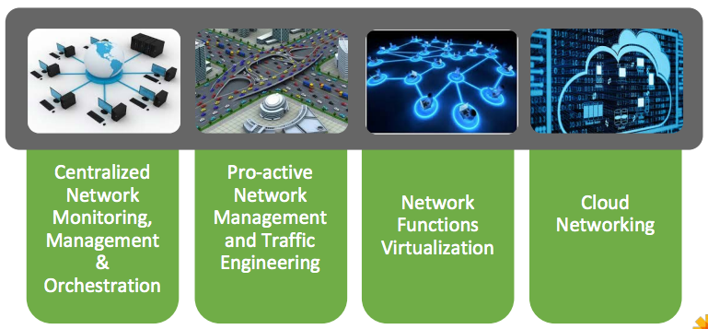
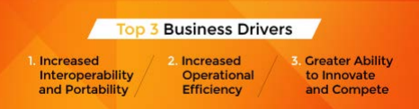
Benefits of Networking

Slide 34
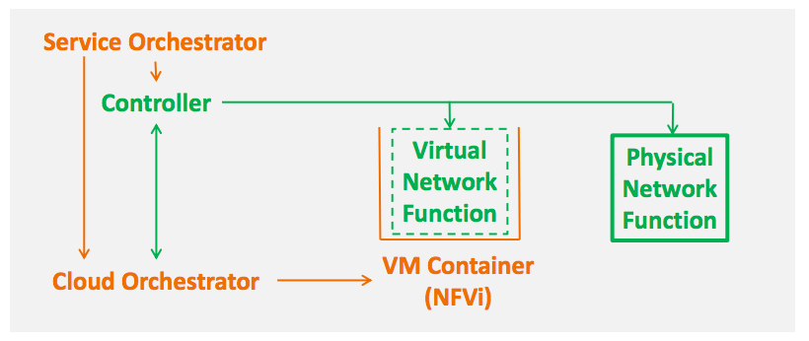
Network in a Virtualized World
http://events.linuxfoundation.org/sites/events/files/slides/odl_summit15_chiosi.pdf

Slide 35
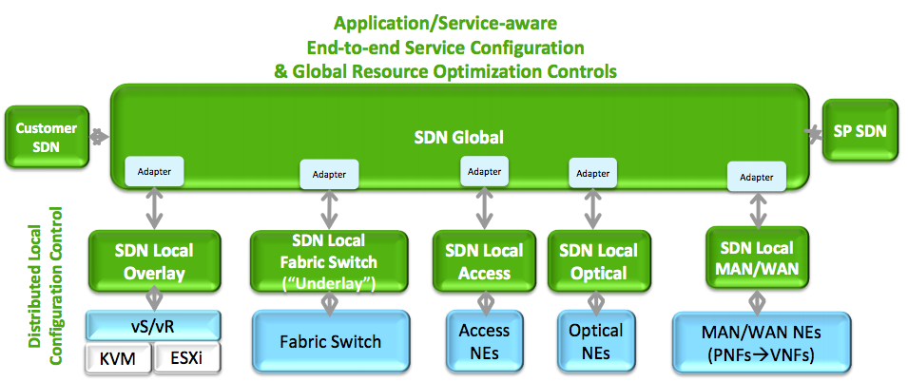
Extension
AI: From reactive to proactive
http://events.linuxfoundation.org/sites/events/files/slides/odl_summit15_chiosi.pdf
Notes:
AI: From reactive to proactive

Slide 36
Solution I: Outsourcing---Let Others Do the Work
25%
4%
On-Premise/Private Cloud IT spend Growth Rate 2013-2017
Off-Premise/Public Cloud IT spend Growth Rate 2013-2017
$2T
$44B
On-Premise/Private Cloud Total Enterprise Investments 2014
Off-Premise/Public Cloud Total Enterprise Investments 2014
Source: Patrick Gelsinger, VMWare 2015.
Notes:
Even by 2020, 70% in premise.

